Slide 1
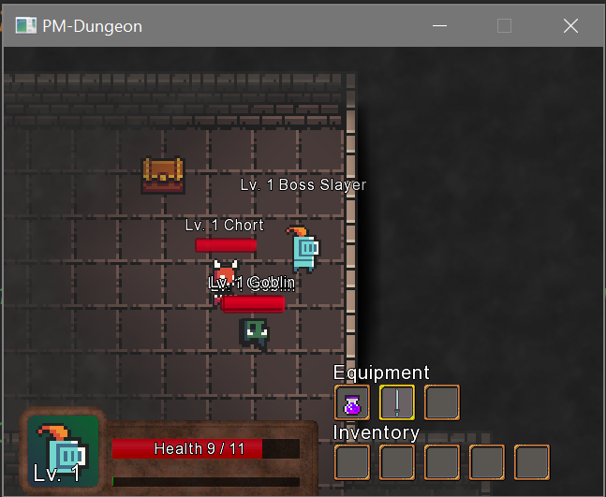
Group PaAdMi
author:
- Paul Nagel (paul_merlin.nagel@fh-bielefeld.de)
- Adrian Koß (adrian.koss@fh-bielefeld.de)
- Michael Herber (michael.herber@fh-bielefeld.de)
Crawl through!

Slide 2
Swing Implementierung
/** * Creates a window in which the player has to enter a name for the hero. It then checks if the entered name is accepted * and sets the name as the hero's name if it is accepted. The window only closes if a accepted name is entered. * */ public class WindowForPlayername{ JTextField textField; private static String playerName = null; JFrame frame;

Slide 3
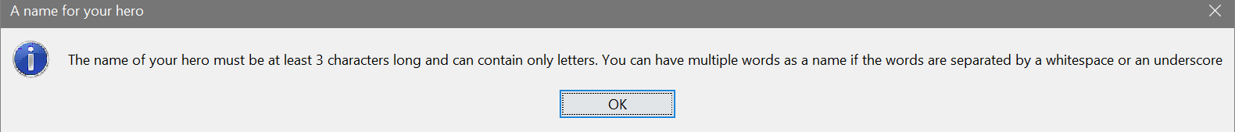
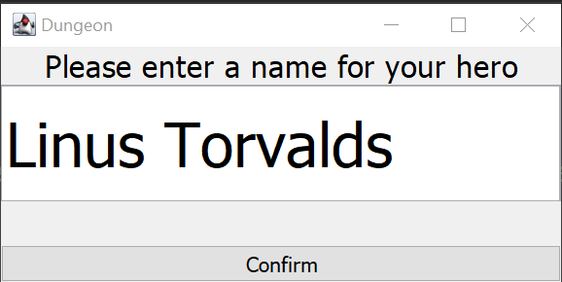
Eingabeaufforderung
Infobox erscheint
Erneute Info
Spiel wird gestartet
Informiert Spieler über Charakter-Namen-Eingabe
Spieler wird erneut informiert
Eingabeaufforderung erscheint
Spieler muss Namen eingeben
Name falsch
Implementierung durch Swing
Name richtig
Spiel startet
Das Main-Game wird ausgeführt

Slide 4

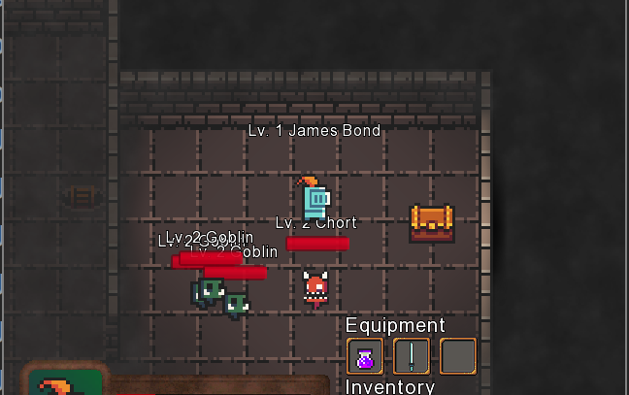
Monster Progression
/** * Spawns random monster in the Dungeon. Their strength depends on the current level the hero is in. * If the hero reaches a certain level, stronger monster start to spawn in greater numbers. * */ public class EnemySpawner { // current level the hero is in private int dungeonLevelCounter = 1; //experience monster get if the hero progresses in the dungeon private int creatureExp = 10;
Level Up
Mobs gain ExP
Mobs go lvl up
Mobs getting stronger
Mobs do more damage
Lizzards spawn
Boss spawn at lvl 5

Slide 5

Random Item Generator
/** * Generates a random item with a name and stats randomly assigned but also based upon the current level the hero is in. * So in the beginning the items will be rather weak and have corresponding names. In the end stages of the game the * items will be strong and have impressively sounding names. * * This class is built as a singleton. */
Wahrscheinlichkeiten:
Range Weapons
1/3
Melee Weapons
1/3
public class RandomItemGenerator { private static RandomItemGenerator instance; private final Random random = new Random(); private final ArrayList<String> itemAdjectivesWeak = new ArrayList<>(Arrays.asList("Weak", "Fragile", "Useless", "Tiny")); private final ArrayList<String> itemAdjectivesStandard = new ArrayList<>(Arrays.asList("Normal", "Average", "Standard")); private final ArrayList<String> itemAdjectivesStrong = new ArrayList<>(Arrays.asList("Powerful", "Enchanted", "Legendary", "Dangerous"));
Potions
1/3

Slide 6
Refactoring
Beispiel:
Monster spawn in separater Klasse
Testing
Refactoring
/** * places Enemies at random locations in the dungeon. * stronger monster start spawning if hero reaches floor 3. * * @param level the dungeon of the game */ public void placeEnemies(DungeonLevel level) { //spawns 5 monster at random locations for(int i = 0; i < 5; ++i) { final Point pos = level.getDungeon().getRandomPointInDungeon(); Creature toSpawn = switch(level.getRNG().nextInt(4)) { case 0 -> new Demon(); case 1 -> new Goblin(); case 2 -> new Lizard(); case 3 -> new Chort(); default -> throw new IllegalArgumentException("Unexpected value [spawn entity]"); };
Refactoring
Testing

